Slide 1

7th Grade Math
Unit 1, Lesson 3 Rational Numbers and Absolute Value Volume 1, pg. 14

Slide 2


Benchmarks
6.NSO.1.1
Extend previous understanding of numbers to define rational numbers. Plot, order, and compare rational numbers.
6.NSO.1.2
Given a mathematical or real-world context, represent quantities that have opposite directions using rational numbers. Compare them on a number line and explain the meaning of zero within its context.
6.NSO.1.3
Given a mathematical or real-world context, interpret the absolute value of a number as the distance from zero on a number line. Find the absolute value of rational numbers.
volume 1, pg. 14

Slide 3
Integrated Mathematical Thinking and Reasoning Standards
MA.K12.MTR.2.1 Demonstrate understanding by representing problems in multiple ways.
MA.K12.MTR.4.1 Engage in discussions that reflect on the mathematical thinking of self and others.
volume 1, pg. 14

Slide 4

Learning Targets
I can plot, compare, and order rational numbers in a mathematical or real-world context.
I can compare and perform operations involving the absolute value of two numbers.
volume 1, pg. 14

Slide 5

Warm-Up
volume 1, pg. 14

Slide 6
1.3.1 Warm-Up: Math Talk
Are there more inches in a mile or seconds in a day?
Discuss with your partner and justify your reasoning mathematically.
volume 1, pg. 14

Slide 7

Refresher
volume 1, pg. 15

Slide 8

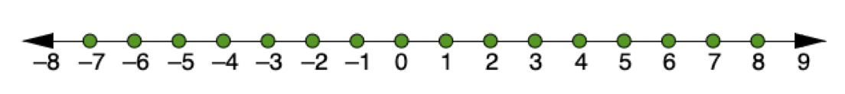

1.3.2 Refresher: Rational Numbers, Integers, and Negative Numbers
The values in green on the number line are some of the values in the set of integers.
The set of rational numbers includes all integers as well as the fractional parts between integers on the number line.
Rational numbers are numbers that can be expressed as the ratio of two integers.
volume 1, pg. 15

Slide 9
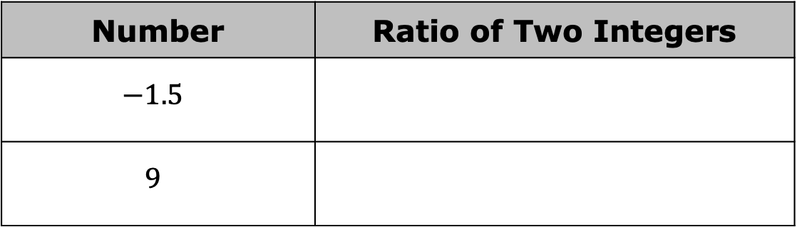
Use the definition of rational numbers to write each number as a ratio of two integers.
Number | Ratio of Two Integers
$$−1.5$$
$$9$$
volume 1, pg. 15

Slide 10

Guided Practice
volume 1, pg. 15

Slide 11

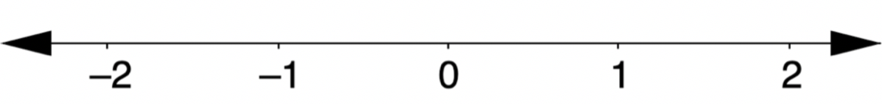
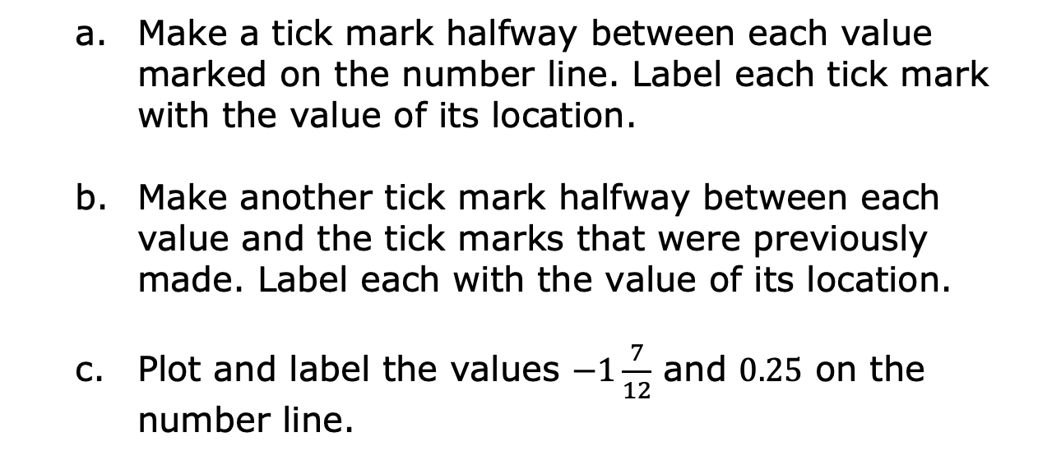
1.3.3 Guided Practice: Plotting Rational Numbers on the Number Line
Use the number line shown to complete the following.
Make a tick mark halfway between each value marked on the number line. Label each tick mark with the value of its location.
Make another tick mark halfway between each value and the tick marks that were previously made. Label each with the value of its location.
Plot and label the values $−1\frac{7}{12}$ and $0.25$ on the number line.
volume 1, pg. 15

Slide 12

Four values are shown.
$$0.4 −15\% 12\% −0.25$$
Plot each of the values on the number line. Label each point with its numeric value.
Complete the inequality statement to show the relationship between the values.
_______ $<$ _______ $<$ _______ $<$ _______
volume 1, pg. 15

Slide 13
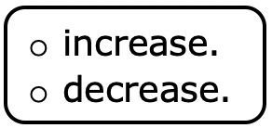
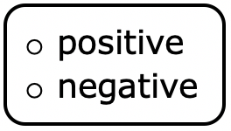
Complete the statements.
When moving from left to right ($→$) on the number line,
The values This can be described
as moving in a direction.
When moving from right to left ($←$) on the number
line, the values This can be described
As moving in a direction.
volume 1, pg. 16

Slide 14
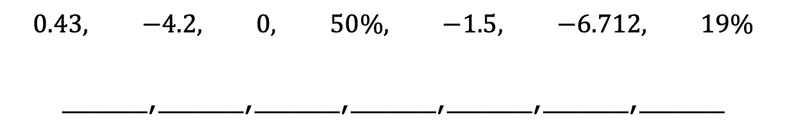
Order these values from least to greatest.
$$0.43, −4.2, 0, 50\%, −1.5, −6.712, 19\%$$
_____, _____, _____, _____, _____, _____, _____
volume 1, pg. 16

Slide 15
Guided Practice
volume 1, pg. 16

Slide 16
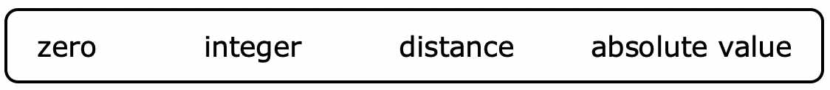
1.3.4 Guided Practice: Absolute Value
Using words from the bank below, complete the statements. Not all words will be used.
Pairs of opposite values are the same ______________ from zero on the number line. They are mirror images of each other, with a line of symmetry through _________. The distance a number is from zero on a number line is called ___________________.
volume 1, pg. 16

Slide 17
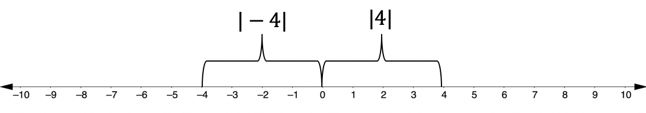


Complete the statement.
The absolute value of $4$ and $−4$ is ____ because they are both $4$ units from $0$ on the number line.
The symbol for absolute value is two vertical bars around a number. The absolute value of $4$ is written as $\left|4\right|$.
$\left|4\right|=4$ and $\left|−4\right|=4$
volume 1, pg. 16

Slide 18
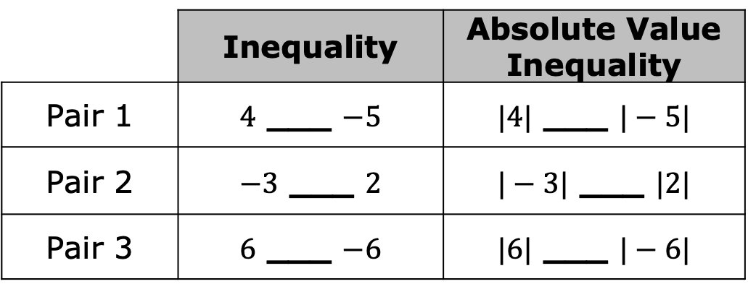

Compare each pair of values and their absolute values.
For each row, use the symbols $>, <$ , or $=$ to complete each inequality.
Discuss what you notice about the comparisons with your partner. Then, summarize your discussion.
 | Inequality | Absolute Value Inequality
Pair 1 | $4$ ___ $−5$ | $|4|$ ___ $|−5|$
Pair 2 | $−3$ ___ $2$ | $|−3|$ ___ $|2|$
Pair 3 | $6$ ___ $−6$ | $|6|$ ___ $|−6|$
volume 1, pg. 17

Slide 19
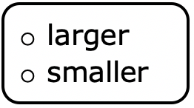
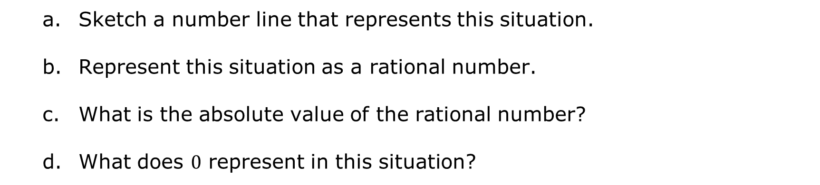
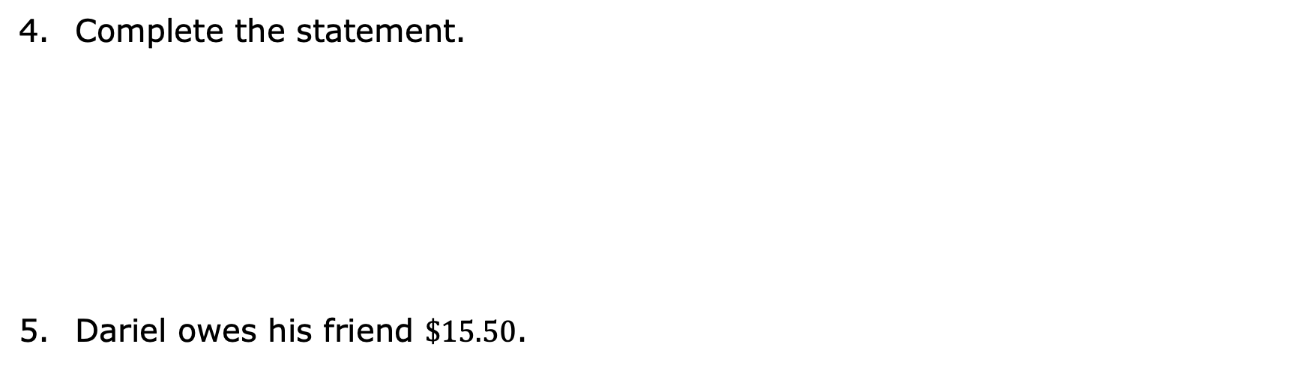
Complete the statement.
Dariel owes his friend $\$15.50$.
When comparing the absolute values of two numbers, numbers that are closer to zero will always have the absolute value.
Sketch a number line that represents this situation.
Represent this situation as a rational number.
What is the absolute value of the rational number?
What does $0$ represent in this situation?
volume 1, pg. 17

Slide 20

Try It
volume 1, pg. 18

Slide 21

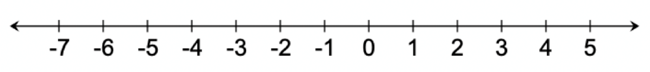

1.3.5 Try It: Absolute Value
Complete each statement and model it on the number line given.
$\left|−7.8\right|$ = _______
$\left|______\right|$ = $3\frac{1}{2}$
volume 1, pg. 18

Slide 22
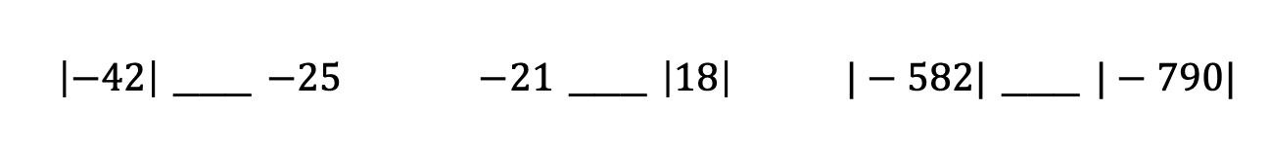

What must be true about two numbers that have the same absolute value?
Use the symbols $> , < ,$ or $=$ to compare each pair of values.
$\left|−42\right|$ ___ $−25$ | $−21$ ___ $\left|18\right|$ | $|−582|$ ___ $|−790|$
volume 1, pg. 18

Slide 23

Wrap-Up
volume 1, pg. 18

Slide 24
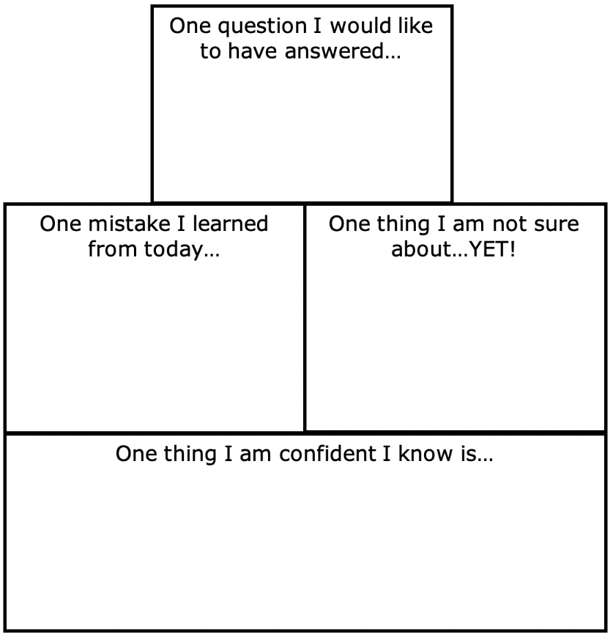
1.3.6 Wrap-Up: Reflection
Complete the learning pyramid.
volume 1, pg. 18

